Slide 1

Data Structure & Algorithms (PCC-CS301)
Lecture 2
Dr. Dipak Kumar Kole
Associate Professor, Dept. of CSE, JGEC
Email: dipak.kole@cse.jgec.ac.in

Slide 2
Outline : Lecture 2
Different cases of Time Complexities
Best case
Average case
Worst case
Example
Asymptotic Notations ( O, o, Ω, ω, ϴ)
Why do we study asymptotic notations?
Big oh (O)
Small oh (o)
Big omega (Ω)
Small omega (ω)
Theta (ϴ)

Slide 3
Different cases of Time Complexities Analysis:
Time Complexity Analysis
Best case Analysis
Average case Analysis
Worst case Analysis
Best case Analysis: It defines the input for which an algorithm will take minimum time to execute.
Worst case Analysis: It defines the input for which an algorithm will take maximum time to execute.
Average case Analysis: It is usually harder to analyze the average behaviour of an algorithm than to analyze the behaviour in the worst case. In this case, we assume that all inputs of a given size are equally likely and do the probabilistic analysis for the average case.

Slide 4
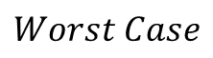
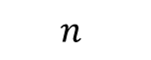
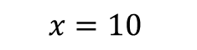
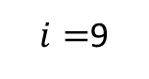
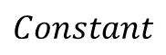
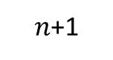
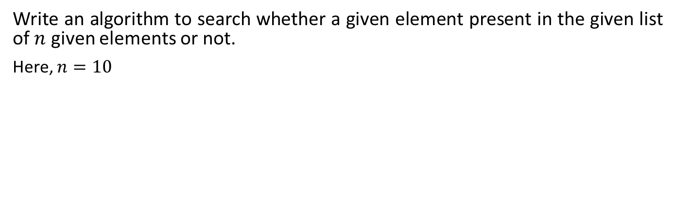
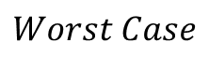
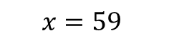
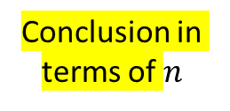
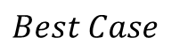
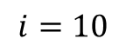
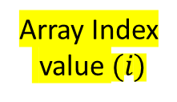
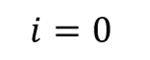
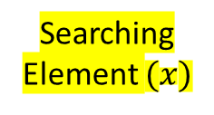
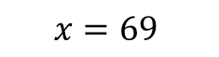
Example to understand the best case, worst case and average case analysis of an Algorithm:
Write an algorithm to search whether a given element present in the given list of $n$ given elements or not.
Here, $n=10$
0 | 1 | 2 | 3 | 4 | 5 | 6 | 7 | 8 | 9
10
a
10 | 15 | 5 | -20 | 35 | 33 | 25 | 60 | 89 | 59
Searching
Element $(x)$
No. of
comparison
Array Index
value $(i)$
Case Analysis
Conclusion in terms of $n$
$$x=10$$
1
$$i=0$$
$$Best Case$$
$$Constant$$
$$x=59$$
10
$i=$9
$$Worst Case$$
$$n$$
$$x=69$$
11
$$i=10$$
$$Worst Case$$
$n$+1

Slide 5
Linear Search Algorithm:
int search ( int x, int n)
{
int i, flag=0;
for (i=0; ((i<n) && (!flag)); i++)
{
if (x==a[i])
{
flag=1;
break;
}
}
if(flag)
return(i);
else
return (-1); // Invalid position to indicate unsuccessful search
}
Here, in this function, we have used a flag variable to indicate the status of searching operation at the end.
The initial value of flag=0 indicate unsuccessful search.
int search ( int x, int n)
{
int i;
for (i=0; ((i<n) && (x!=a[i])); i++);
if(i<n)
return(i);
else
return (-1);
}
Here, in this function, we have used the value of array index i to indicate the status of searching operation at the end.

Slide 6
Worst case time Complexity of Linear Search Algorithm:
int search ( int x, int n)
{
int i;
for ( i=0; ((i<n) && (x!=a[i])); i++ );
if(i<n)
return(i);
else
return (-1);
}
Unit Time
1
2x(n+1)
n
1
1
$$T\left(n\right)= 1+2∗(n+1)+n+1+1=3n+5$$

Slide 7
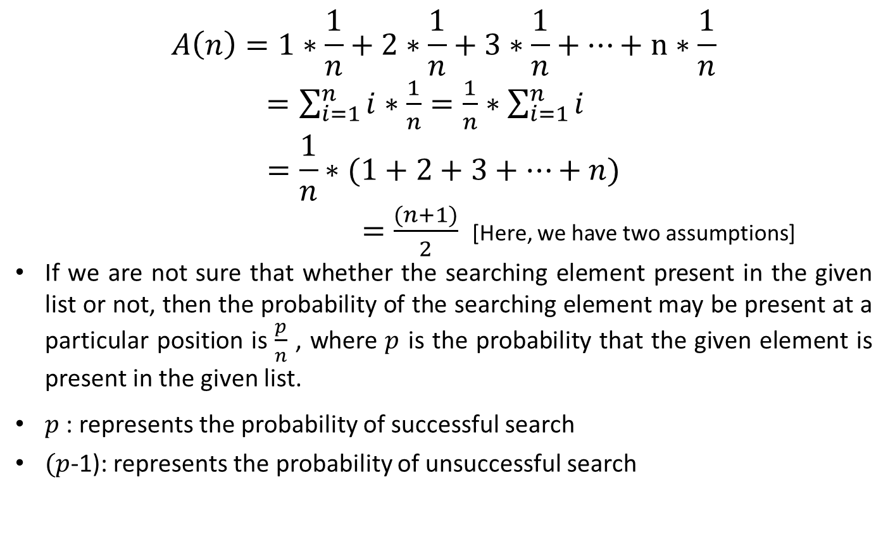
Best case time Complexity of Linear Search Algorithm:
$T\left(n\right)=5$ (Constant time which is independent of the problem input size $n$)
Average case time Complexity of Linear Search Algorithm:
$$A\left(n\right)=1∗\frac{1}{n}+2∗\frac{1}{n}+3∗\frac{1}{n}+…+n∗\frac{1}{n}$$
$=\sum_{i=1}^{n}{i∗\frac{1}{n}}=\frac{1}{n}∗\sum_{i=1}^{n}{i}$
$$=\frac{1}{n}∗(1+2+3+…+n)$$
$=\frac{(n+1)}{2}$ [Here, we have two assumptions]
If we are not sure that whether the searching element present in the given list or not, then the probability of the searching element may be present at a particular position is $\frac{p}{n}$ , where $p$ is the probability that the given element is present in the given list.
$p$ : represents the probability of successful search
$(p$-1): represents the probability of unsuccessful search

Slide 8
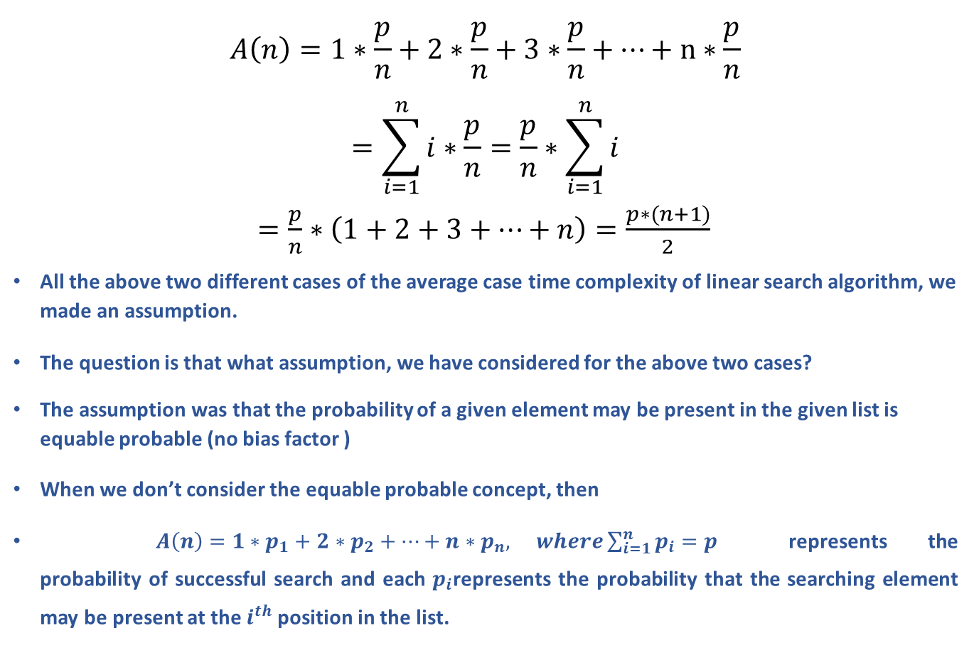
Average case time Complexity of Linear Search Algorithm: (Cont..)
$$A\left(n\right)=1∗\frac{p}{n}+2∗\frac{p}{n}+3∗\frac{p}{n}+…+n∗\frac{p}{n}$$
$$=\sum_{i=1}^{n}{i∗\frac{p}{n}}=\frac{p}{n}∗\sum_{i=1}^{n}{i}$$
$=\frac{p}{n}∗\left(1+2+3+…+n\right)=\frac{p∗(n+1)}{2}$
All the above two different cases of the average case time complexity of linear search algorithm, we made an assumption.
The question is that what assumption, we have considered for the above two cases?
The assumption was that the probability of a given element may be present in the given list is equable probable (no bias factor )
When we don’t consider the equable probable concept, then
$A\left(n\right)=1∗p_{1}+2∗p_{2}+…+n∗p_{n}, where\sum_{i=1}^{n}{p_{i}}=p$ represents the probability of successful search and each $p_{i}$represents the probability that the searching element may be present at the $i^{th}$ position in the list.

Slide 9
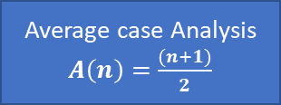
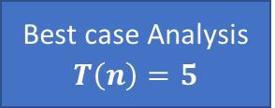
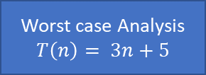
Different cases of Time Complexities of Linear Search Algorithm:
Time Complexity Analysis: Linear Search Algorithm
Best case Analysis $T\left(n\right)=5$
Average case Analysis $A\left(n\right)=$ $\frac{(n+1)}{2}$
Worst case Analysis $T\left(n\right)= 3n+5$
Most of the time, when we analyze the time complexity of an algorithm, we are concerned with the worst case time complexity

Slide 10




Asymptotic Notations ( O, o, Ω, ω, ϴ):
Why study Asymptotic Notations ?
Dipak
Sourav
Ranjit
Dipak, Ranjit, and Sourav
Who is the tallest among these three?

Slide 11
Why study Asymptotic Notations ? (Cont..)
Who is the tallest among these three?
Calculating the individual height, we can get the answer.
(Using Exact individual computation)
Without Calculating the exact individual height, we can get the answer using approximation.
(Using the idea of individual solution)
This is very time consuming process with respect to other (More time is required to get the answer)
This is very easy process with respect to other (less time is required to get the answer)
The asymptotic notations give us the idea about the time complexity of an algorithm.
With the help of this beautiful idea, we find the best (efficient) algorithm

Slide 12
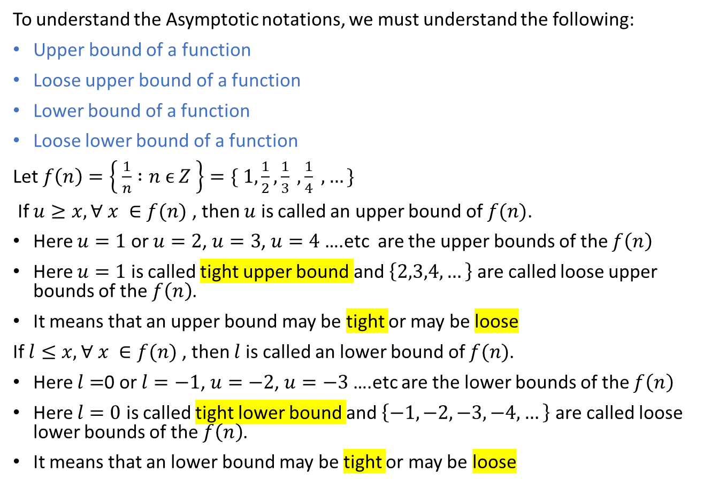
Asymptotic Notations ( O, o, Ω, ω, ϴ): (Cont..)
To understand the Asymptotic notations, we must understand the following:
Upper bound of a function
Loose upper bound of a function
Lower bound of a function
Loose lower bound of a function
Let $f\left(n\right)=\left\{ \frac{1}{n} :n ϵ Z \right\}=\{ 1,\frac{1}{2},\frac{1}{3} ,\frac{1}{4} , …\}$
If $u≥x, ∀ x ∈f(n)$ , then $u$ is called an upper bound of $f(n)$.
Here $u=1$ or $u=2$, $u=3$, $u=4$ ….etc are the upper bounds of the $f\left(n\right)$
Here $u=1$ is called tight upper bound and $\left\{2,3,4,…\right\}$ are called loose upper bounds of the $f\left(n\right)$.
It means that an upper bound may be tight or may be loose
If $l≤x, ∀ x ∈f(n)$ , then $l$ is called an lower bound of $f(n)$.
Here $l=$0 or $l=−1$, $u=−2$, $u=−3$….etc are the lower bounds of the $f\left(n\right)$
Here $l=0$ is called tight lower bound and $\left\{−1,−2,−3,−4,…\right\}$ are called loose lower bounds of the $f\left(n\right)$.
It means that an lower bound may be tight or may be loose

Slide 13

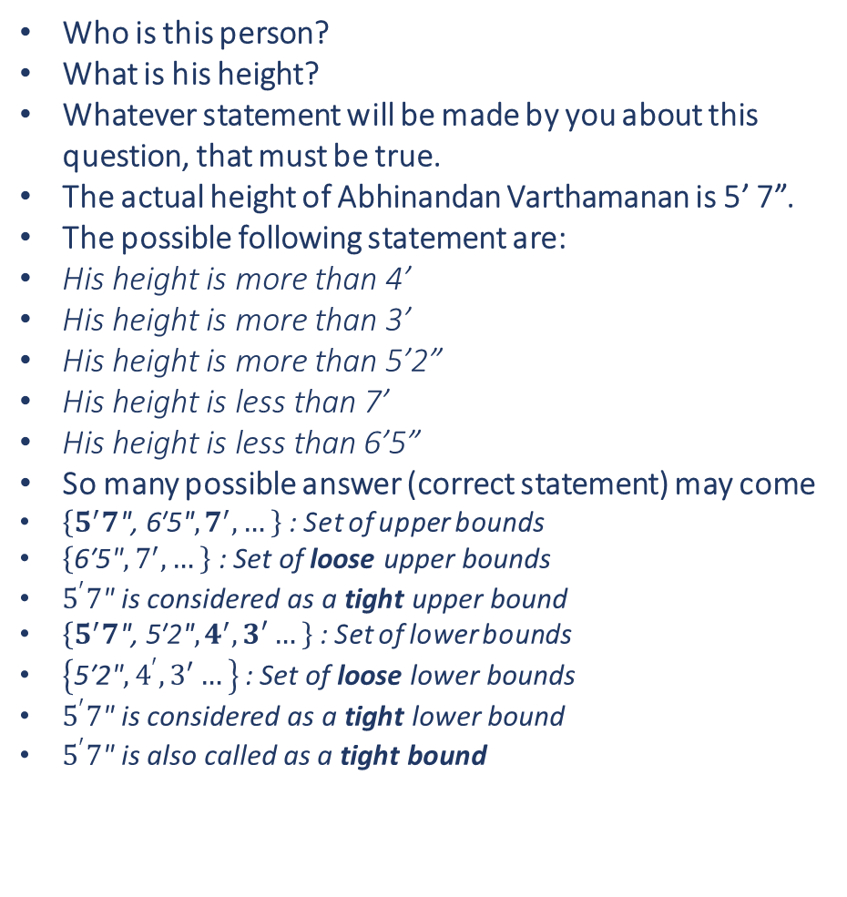
Understanding the upper & Lower Bounds Concepts
Who is this person?
What is his height?
Whatever statement will be made by you about this question, that must be true.
The actual height of Abhinandan Varthamanan is 5’ 7”.
The possible following statement are:
His height is more than 4’
His height is more than 3’
His height is more than 5’2”
His height is less than 7’
His height is less than 6’5”
So many possible answer (correct statement) may come
$\left\{5^{′}7\text{", 6′5"}, 7^{′},…\right\}$ : Set of upper bounds
$\left\{\text{6′5"}, 7^{′},…\right\}$ : Set of loose upper bounds
$5^{′}7\text{" }\text{is} \text{considered} \text{as} \text{a} \text{tight} \text{upper} \text{bound}$
$\left\{5^{′}7\text{", 5′2"}, 4^{′},3′…\right\}$: Set of lower bounds
$\left\{\text{5′2"}, 4^{′},3′…\right\}$: Set of loose lower bounds
$5^{′}7\text{" }\text{is} \text{considered} \text{as} \text{a} \text{tight} \text{lower} \text{bound}$
$5^{′}7\text{" }\text{is} \text{also} \text{called} \text{as} \text{a} \text{tight} \text{bound}$
Abhinandan Varthamanan, Fighter Pilot, Indian Air Force

Slide 14
Asymptotic Notations ( O, o, Ω, ω, ϴ): (Cont..)
Big Oh (O): The big oh of a function gives us the idea of the asymptotic upper bound of a function.
Small oh(o): The small oh of a function gives us the idea of the asymptotic loose upper bound of a function.
Big Omega (Ω): The big omega of a function gives us the idea of the asymptotic lower bound of a function.
Small omega (ω): The small omega of a function gives us the idea of the asymptotic loose lower bound of a function.
Theta (ϴ): The theta of a function gives us the idea the asymptotic tight bound of a function.

Slide 15
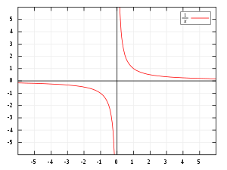
Asymptotic Notations ( O, o, Ω, ω, ϴ): (Cont..)
What does asymptotic mean?
The definition of asymptotic is a line that approaches a curve but never intersect (never crossing).
A curve and a line that get closer but do not intersect are examples of a curve and a line that are asymptotic to each other.

Slide 16
Conclusion of Lecture 2:
We have covered the following:
Different cases of Time Complexities
Best case
Average case
Worst case
Example
Asymptotic Notations ( O, o, Ω, ω, ϴ)
Why do we study asymptotic notations?
Big oh (O)
Small oh (o)
Big omega (Ω)
Small omega (ω)
Theta (ϴ)
To be discussed the following in the Lecture 3:
Formal Definition of Individual Asymptotic Notation
Geometrical Interpretation of each Asymptotic Notation
Examples to understand the corresponding notation
Properties of Big Oh Asymptotic Notation

